Slide 1
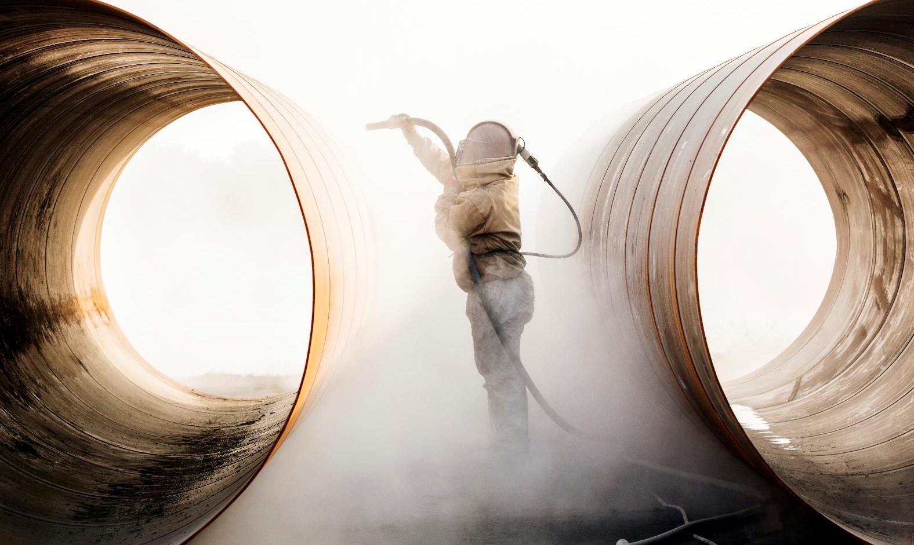
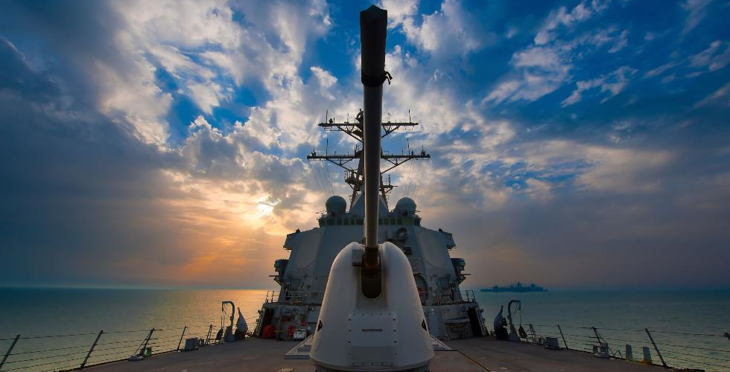
MARCOM Services
Founded in 2012, MARCOM is the premier choice for marine preservation services: We sandblast, paint, and repair U.S. Navy Ships. We are a small business focused on customer and employee satisfaction.

Slide 2
What we do: Corrosion Control / Preservation
Where there is a lot of metal, there is a lot of rust. Rust is the result of a chemical reaction between air, water, and iron. Add salt water to the mix, and corrosion accelerates. Ships are full of saltwater systems and salty ocean air. Corrosion on ships is a huge problem.
The United States Navy spends $6 Billion a year fighting corrosion.
We implement state-of-the-art technologies to achieve top quality corrosion control results. We preserve ships by removing corrosion and applying specialized coatings that help prevent rust.
We preserve in-service ships during their maintenance availabilities
We preserve Aircraft Carrier and Submarine modules during new construction

Slide 3
Our Services
Abrasive Blasting
Ultra-High Pressure
Hydro Blasting
Research & Development
Our mission is to deliver high quality corrosion control and preservation services. MARCOM has extensive experience in providing these specialized services
Coating Applications
Non-Skid Applications
PCMS Tile Installation

Slide 4
Why MARCOM?
We treat our employees with respect and foster a work environment that is welcoming to all. We offer competitive pay, ongoing training, great benefits, and safety-focused practices. MARCOM is a great place to work!
315%
401K
<100
20
Growth
Benefits
Small Business
Roaring 20 Honoree
We have grown 315% over the past 5 years. We’re looking for a young workforce who wants to grow with us
All employees are eligible for benefits that include, but are not limited to, insurance, holiday pay, vacation time, and a 401K plan with company match
We are a small business with less than 100 full time employees. We know each and every one of our employees on a personal level
In 2019, The Virginia Pilot recognized MARCOM as one of Hampton Roads’ most dynamic companies through the Inside Business Roaring 20 awards program.

Slide 5
Prospective Apprentices
This is all we are looking for in our prospective apprentice employees:
Motivated
Hardworking
Smart
We want young folks who will show up everyday eager to learn and work hard. We will teach you the business, including these disciplines: warehousing, logistics, diesel and electrical mechanics, shipyard industry, surface prep & coatings application, quality assurance inspection, health, safety and OSHA inspections, leadership, cost estimating, and project management.

